Slide 1
Living in a Socioeconomically Distressed Community is Associated with Adverse Outcomes Following Hip Fracture Surgery
Janice M. Bonsu, MPH
December 8, 2020
International Geriatric Fracture Society

Slide 2
Disclosures
None

Slide 3
Health Inequity
The disparity in health outcomes that is systematic, avoidable, and unjust.
Notes:
Not just a buzz word. health inequity is defined by the CDC as the difference or disparity in health outcomes that is systematic, avoidable, and unjust.

Slide 4
10%
of Americans live below the poverty line
(<$28,000/household)
Outcomes following orthopedic interventions are closely tied to social determinants of health
Notes:
Read
We know that these Americans experience significant health disparities, often characterized by indicators such as higher incidence of disease, increased mortality rates, & lower life expectancies.
We also know that
Read
– with unequal outcomes influenced by lack of health insurance, violence, and socioeconomic status

Slide 5
What does this mean?
5 |
Notes:
This means that the same subset of Americans who have a higher morbidity & mortality risk from unintentional injury are more likely to live in socioeconomically distressed communities.
Where are they?

Slide 6
6 |
Notes:
Everywhere.
This is a map from the 2017 Census, highlighting the percentage of people living in poverty in the US. Most of them are centered in the South, but it is clear that poverty is all around us.

Slide 7
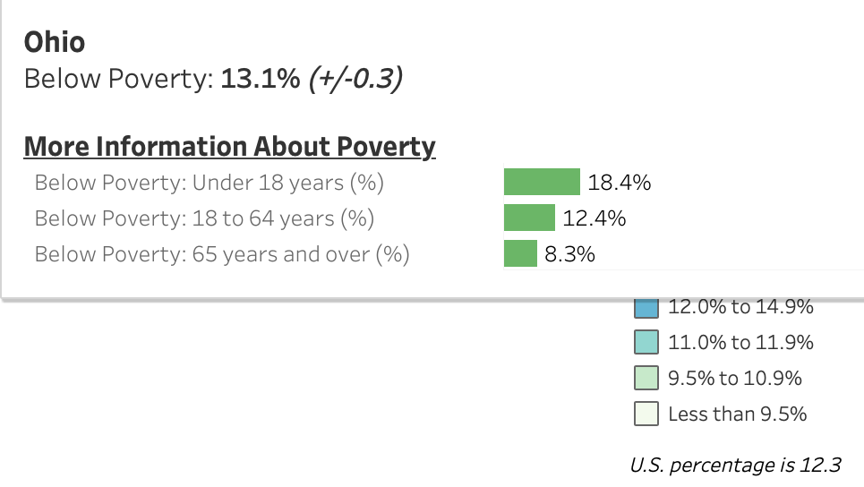
7 |
Notes:
In my own state of Ohio, we have a higher proportion of people living below the poverty line than the US average.
So we know who is at risk.
But, what’s being done?

Slide 8
CAH patients were less likely to experience 90-day surgical complications than patients at non-CAHs
MI (0.80, p< 0.001), Sepsis (0.69, p<0.001), Acute renal failure (0.65, p<0.001), C. difficile (0.77, p<0.001)
CAH patients had a lower 90-day readmission and mortality rate than patients at non-CAHs
90-day readmission rate (0.67, p< 0.001), 90-day mortality rate (0.89, p<0.001)
Notes:
One way of expanding care to underserved regions has been the creation of critical access hospitals.
In 1997, the federal government identified a subset of hospitals in the US that served a critical population and was at risk of financial closure. They introduced a policy to rescue what they established as - Critical Access Hospitals (CAHs). This policy expanded care and maintained the financial viability of rural hospitals.
This is a recent study I worked on that evaluated whether there are differences in care at the CAHs.
Our study found that outcomes ….
Complications:
Read
Why?
CAHs may operate on less surgically complex patients through the process of triaging care to non-CAHs…
Databases allow us to adjust for medical complexity, however ICD-9 codes do not contain granular information on fracture patterns that allow us to adjust for surgical complexity of cases.
Readmissions & mortality:
Read
Why? Post-operative hip fracture patient transfers from CAHs are a common practice, possibly reducing CAH failure-to-rescue rates.
Transfers: 4.1% at CAHs v 1.2% at non-CAH
Methods for CAH paper
1:1 propensity-score matching*: ensure confounding variables related to differences in patient demographics, clinical characteristics, and hospital characteristics were accounted
Multivariate logistic regression: to assess 90-day complications, readmissions, and mortality between the two matched cohorts.
Generalized linear regression: to assess the impact of surgery at a CAH on LOS and 90-day costs.
* Patient demographics: age, gender, Elixhauser Co-morbidity Index
Clinical characteristics: type of fixation, time to surgery)
Hospital characteristics: hospital ZIP code and average annual case volume

Slide 9
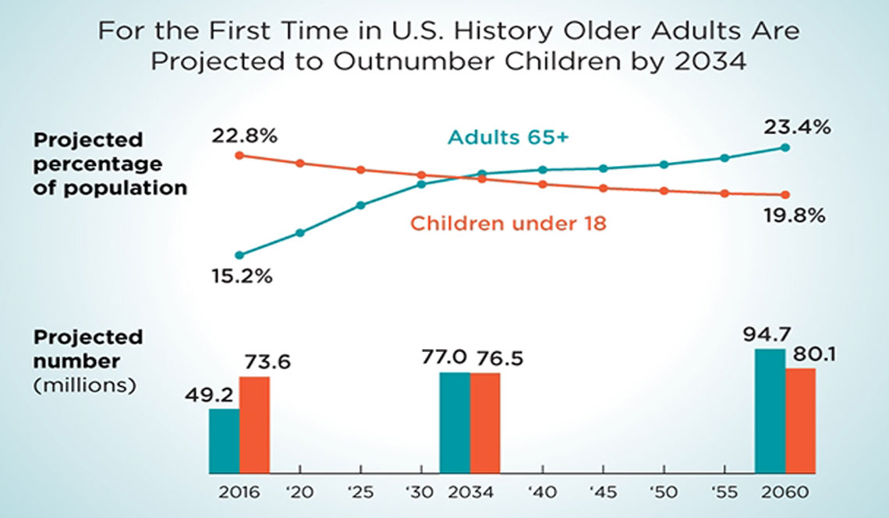
An aging nation
With a growing elderly population, hip fractures remain a serious public health concern in the U.S.
The annual cost of hip fracture care in the U.S. is $5.96 billion
9 |
Notes:
Read
Read

Slide 10
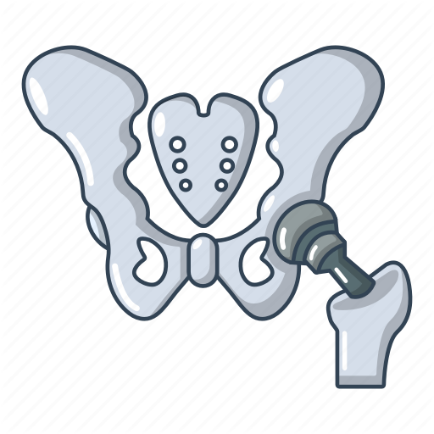
Socioeconomic status: the position of an individual on an economic and social scale that measures factors such as income, education, and place of residence
Education
Neighborhood safety
Epigenetics
Type of residence
Income
Community unemployment
Access to fresh foods
Insurance
10 |
Notes:
Read
Click
The role of sociodemographic factors among hip fracture patients is not well studied.
Although the interaction of sociodemographic factors is complex, addressing these risk factors may lead to improved outcomes and reduced health inequalities.
In order to take into account the complex contributors to a person’s socioeconomic status, researchers have developed a new index.

Slide 11
Distressed Community Index (DCI) Score
NEW MODEL: DCI has been validated as an effective tool to estimate SES
Community unemployment
Housing vacancies
Poverty rate
Median income
Business growth
These scores are normally distributed and range from 0 (no distress) to 100 (severe distress)
PURPOSE: To describe the relationship between DCI
score and patient outcomes after hip fracture
11 |
Notes:
This new index is the Distressed Community Index Score.
Read
So, that’s what we set out to do.

Slide 12
2012-2014 Medicare database
Medicare-eligible patients treated with ORIF, THA, and HA for closed hip fractures
Patients with DCI 21-40
Patients with DCI 0-20
Patients with DCI 41-60
Patients with DCI 61-80
Patients with DCI >80
Residential Zip Code Analysis
Methods
12 |
(No Distress)
(Severe Distress)
Notes:
DCI categories
Increasing number correlates with a higher “distress” score

Slide 13
DCI and patient outcomes after hip fracture
80+
(Severe Distress)
Analysis
1:1 propensity-score matching*: to control for baseline patient, confounding variables related to differences in patient demographics, type of procedure, and hospital-level characteristics
61-80
(Moderate Distress)
41-60
(Some Distress)
Multivariate logistic regression: to the independent impact of increasing DCI score on: (1) 90-day complications, (2) readmissions, and (3) mortality between the 5 cohorts
21-40
(Mild Distress)
0-20
(No Distress)
* Patient demographics: age, gender, region, co-morbidity burden
Type of Procedure : ORIF, THA, HA, and percutaneous pinning
Hospital-level characteristics: teaching status, case volume, ownership, location, bed size
Notes:
For our analysis, we used…
Outcomes of interest:
90-day complications,
readmissions and mortality,
while controlling for:
baseline demographics (age, gender, region, co-morbidity burden),
type of procedure (ORIF, THA, hemiarthroplasty and percutaneous pinning),
and hospital-level characteristics (teaching status, case volume, ownership, location, bed size).

Slide 14
Patient demographics
80+
(Severe Distress)
77,774 (21.4%)
61-80
(Mod Distress)
81,382 (22.4%)
N=364,074
41-60
(Some Distress)
68,717 (18.9%)
21-40
(Mild Distress)
70,406 (19.3%)
0-20
(No Distress)
65,795 (18.1%)
14 |

Slide 15
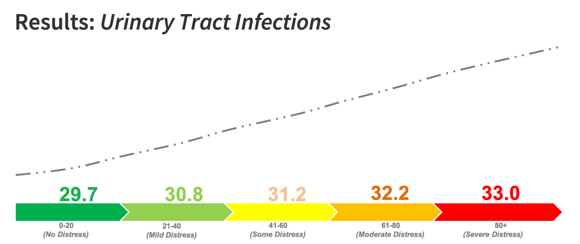
Overall, the higher the DCI score, the higher the odds of post-surgical complication
more likely to get UTIs
OR 1.12
15 |
Notes:
The incidence of UTIs and pneumonia increased with increasing DCI score.

Slide 16
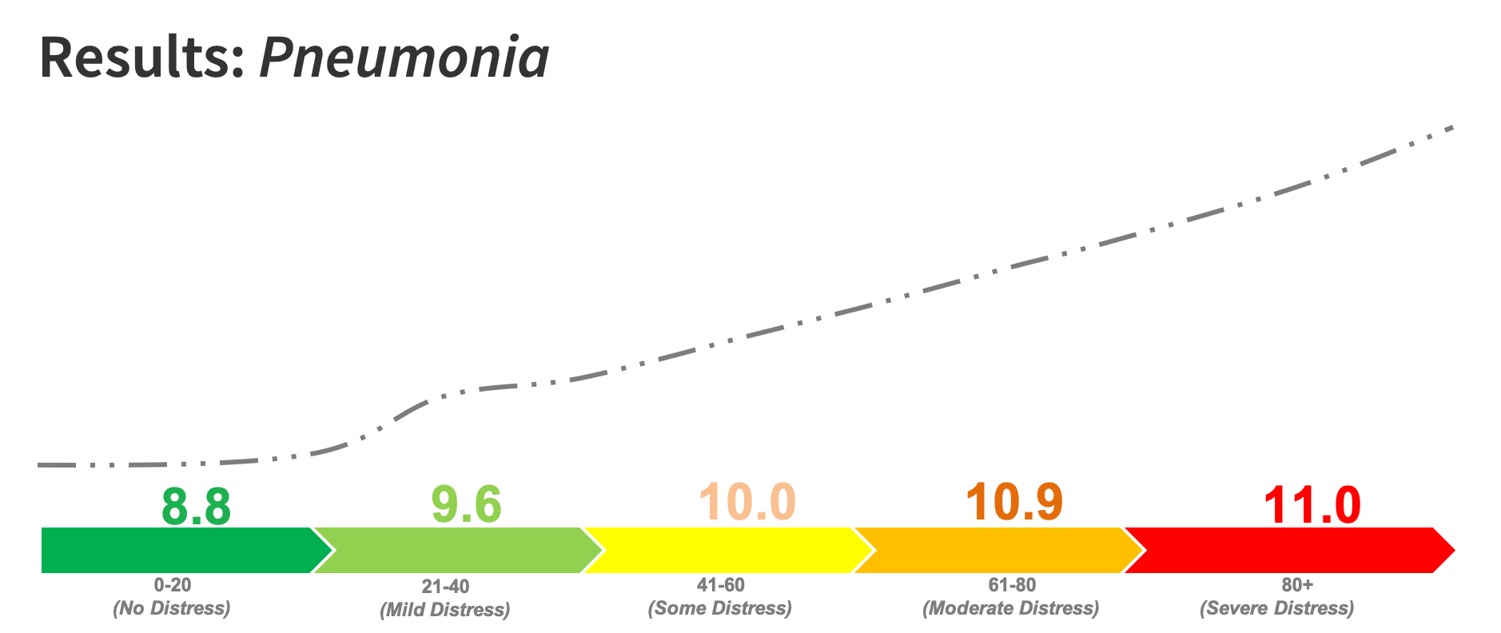
Overall, the higher the DCI score, the higher the odds of post-surgical complication
more likely to get Pneumonia
OR 1.18
16 |
Notes:
The incidence of UTIs and pneumonia increased with increasing DCI score.

Slide 17
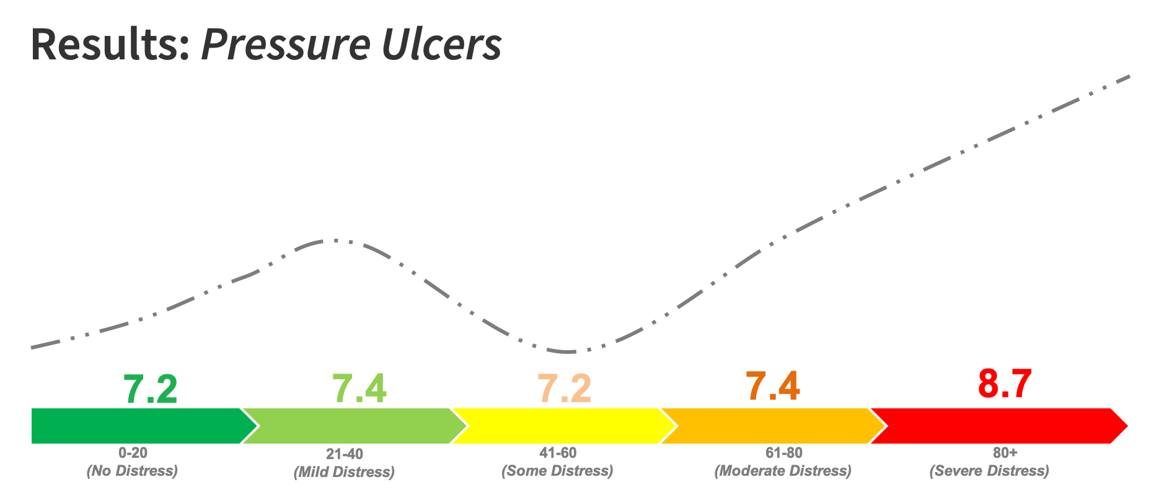
Overall, the higher the DCI score, the higher the odds of post-surgical complication
Biphasic pattern for Pressure Ulcers
OR 1.09
17 |
Notes:
There was a biphasic pattern observed for the risk of pressure ulcers, with mild and severe distressed individuals experiencing higher odds of ulcers
Why? I would love to hear your thoughts on it. We believe this may be due to:
The “mild” distress folks are pretty immobile. They have a lot of help and are probably in mid-tier SNFs because they have health insurance,
Those in the middle with “some distress” are actually the ones better off. These patients are mobile out of necessity. They may not qualify for help to cover SNF costs or perhaps they have enough support at home and went home.
And those in severe distress worse off because they are likely immobile, sent to low-rated SNFs, and thus at an increased risk for pressure ulcers

Slide 18
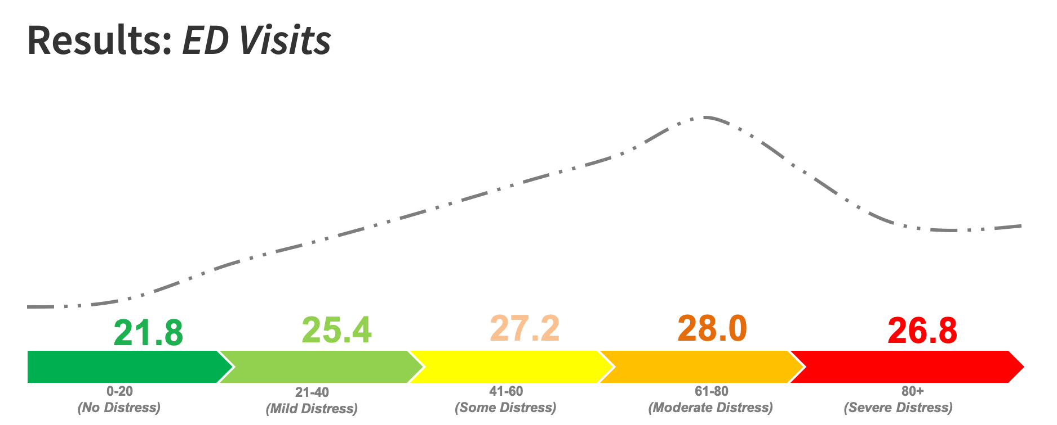
Interestingly, patients with higher DCI score were…
more likely to visit the ED
OR 1.12
18 |

Slide 19
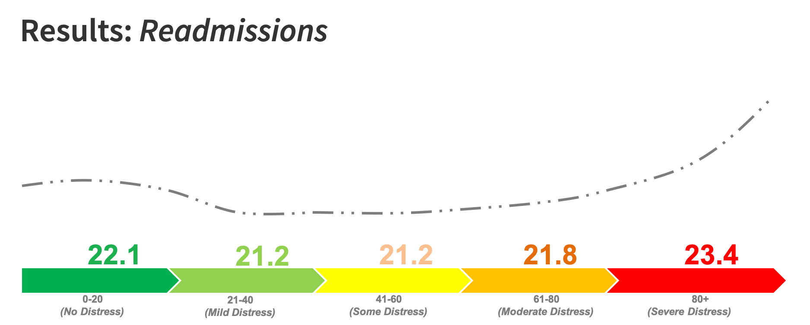
Interestingly, patients with higher DCI score were…
Less likely to be readmitted
OR 0.91
19 |

Slide 20
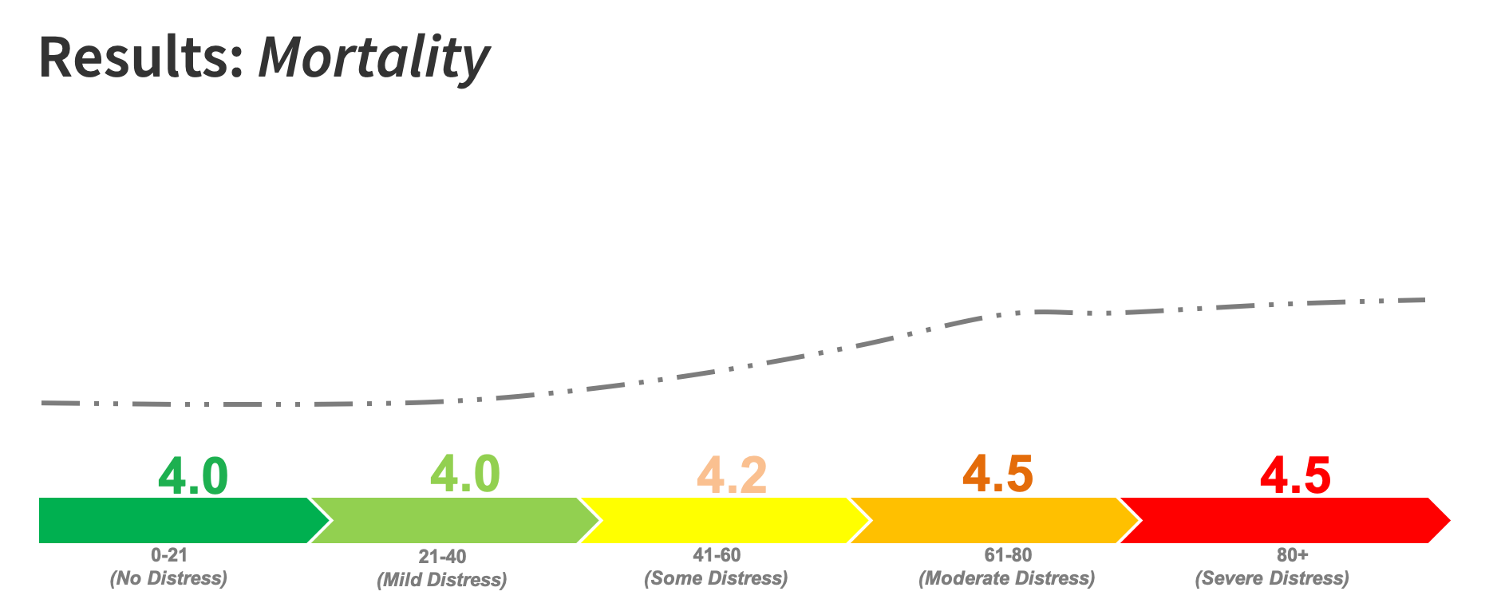
Interestingly, patients with higher DCI score were…
More likely to die
OR 1.14
20 |

Slide 21
Summary
Patients belonging to more distressed communities are at a higher risk of experiencing complications, including death, following hip fracture surgery.
Individualizing healthcare outreach and resources has the potential to mitigate the risks of adverse outcomes in vulnerable patient populations.

Slide 22
Future directions
Collect patient DCI score systematically and integrate it into practice decisions
Educate providers on the importance of engaging patients with their DCI risks in mind in order to make healthcare delivery more equitable
Incorporate orthopaedic trauma social workers in Departments to help coordinate social care for at risk patients

Slide 23
Thank you
Department of Orthopaedics, The Ohio State University Wexner Medical Center
Co-authors:
Dr. Azeem Tariq Malik
Mitchell Gray
Dr. Thuan Ly
Dr. Laura Phieffer
Dr. Ryan Harrison
Dr. Carmen Quatman
Senior Research Coordinator:
Jessica Wiseman, MPH

Slide 24
Any questions?
bonsu.janice@gmail.com
@janicebonsu

Slide 25
References
2019 American Community Survey. Census.gov/acs
Allen Butler, R., et al. (2011). "The Frank Stinchfield Award: the impact of socioeconomic factors on outcome after THA: a prospective, randomized study." Clin Orthop Relat Res 469(2): 339-347. Dy, C. J., et al. (2016). "Racial and Socioeconomic Disparities in Hip Fracture Care." J Bone Joint Surg Am 98(10): 858-865.
Adeyemi, A. and G. Delhougne (2019). "Incidence and Economic Burden of Intertrochanteric Fracture: A Medicare Claims Database Analysis." JB JS Open Access 4(1): e0045.
Malik AT, Bonsu JM, Roser M, Khan SN, Phieffer LS, Ly TV, Harrison RK, Quatman CE. (2020). “What Is the Quality of Surgical Care for Patients with Hip Fractures at Critical Access Hospitals?” Clin Orthop Relat Res. Epub ahead of print. PMID: 32833925.
Mehaffey, J. H., et al. (2020). "Socioeconomic "Distressed Communities Index" Improves Surgical Risk-adjustment." Ann Surg 271(3): 470-474.
25 |

